Slide 1
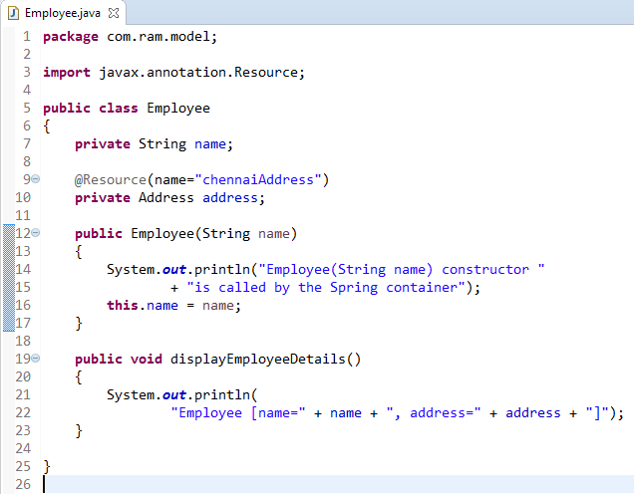
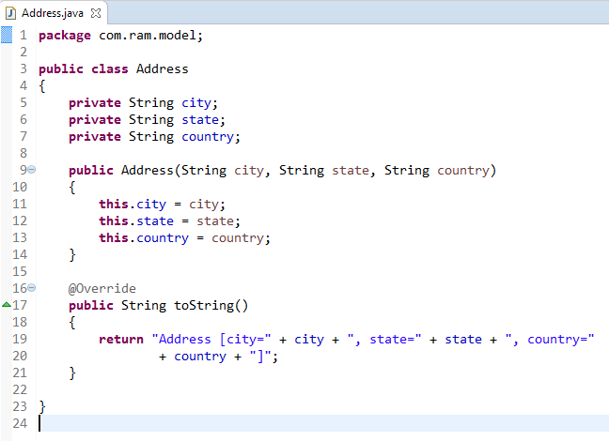
Spring Auto-Wiring Beans with @Resource(name=“beanName”)
The @Resource(name=“beanName") annotation used to control which bean should be autowire on a field.

Slide 2
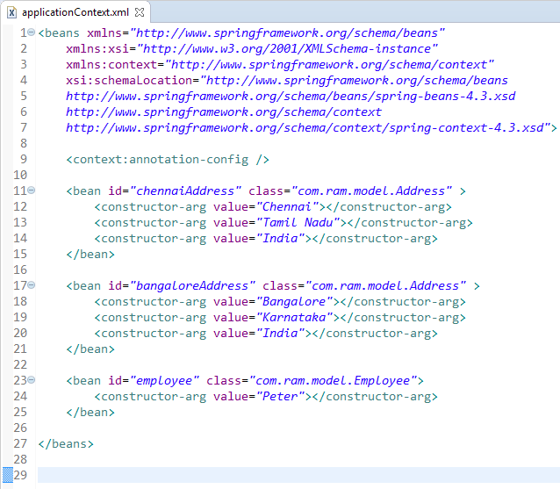
Spring Auto-Wiring Beans with @Resource(name=“beanName”)

Slide 3
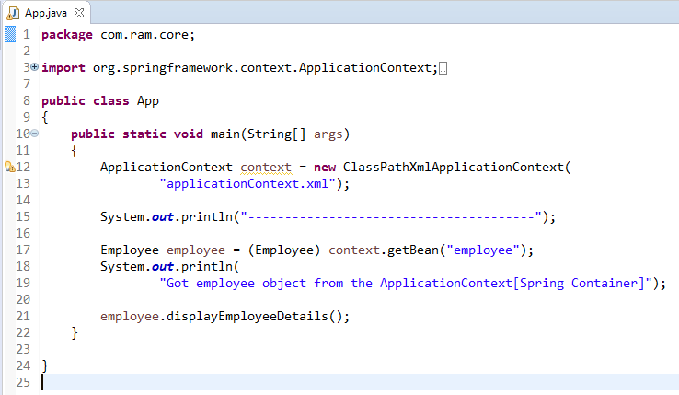
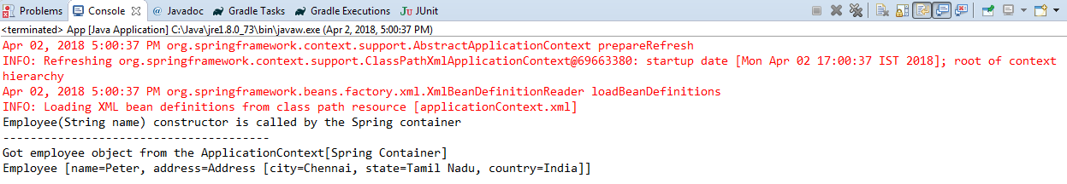
Spring Auto-Wiring Beans with @Resource(name=“beanName”)

